Slide 1
FACILITIES
JACKSON, NH
20
22
V2. November 11, 2022

Slide 2
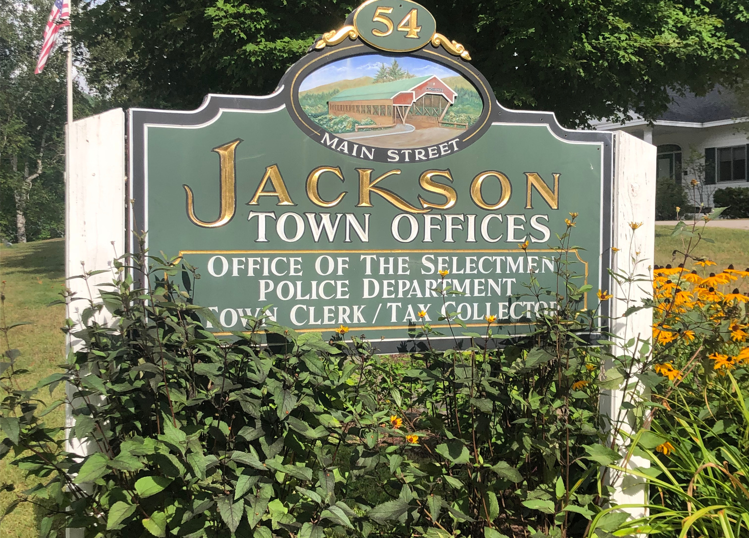
Mission
The mission of the Facilities Committee is to educate the community, especially taxpayers, about the Town of Jackson’s public facilities in order to determine the highest and best use of existing facilities as well as consideration for facilities which may be needed in the future.
20
22

Slide 3
BUILDINGS
20
22

Slide 4
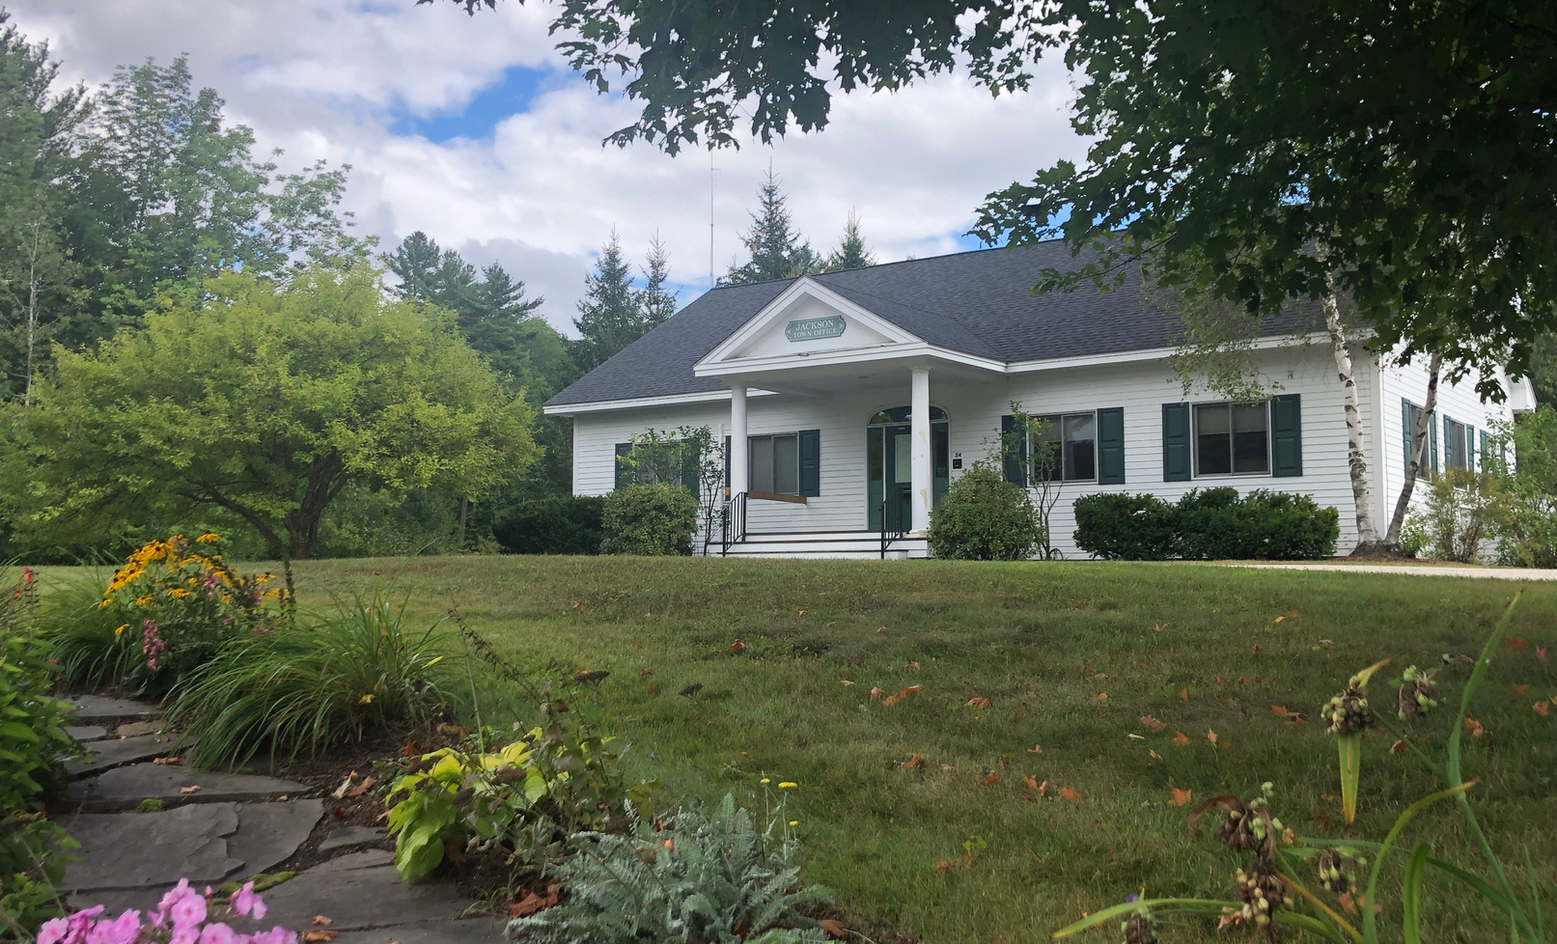
Town Office
R14-8 (View on a map)
Current Use
The Jackson Town Office building is located at 54 Main Street. Here, you will find It houses the municipal functions for the town, including the physical location of the police station.
The Town Office and Library share a 34.5 acre lot, of which most is undeveloped.
Contact
website: jackson-nh.org
phone: 603-383-4223
website: Police Department
phone: 603-383-9292
emergency: 911
20
22

Slide 5
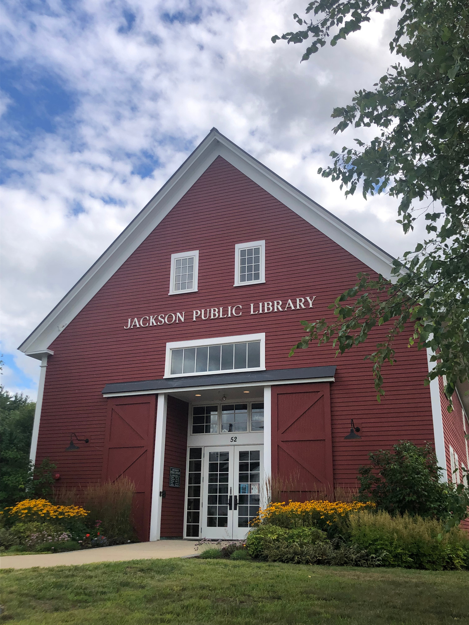
Library
R14-8 (View on a map)
Current Use
The Jackson Public Library is located at 52 Main Street (on the same lot as the town offices and police station).
The building is a restoration of the Old Trickey Barn, which was dismantled and moved from its former location where the Whitney Community Center now stands. It was reconstructed and repurposed as the current Jackson Public Library in 2010.
The library has a large patio space in the rear with seating for patrons and group meetings, in addition to a tent for seasonal outdoor events.
The library collection was previously housed in the building located at 125 Main Street.
For more information, go to jacksonlibrary.org.
Contact
website: Jacksonlibrary.org
phone: 603-383-9731
20
22

Slide 6
Gray's Inn Garage
V01-46 (View on a map)
Current Use
The Gray's Inn garage is located on Main Street adjacent to Flossie's. This facility provides:
Book sale storage for Friends of the Jackson Library
Equipment storage for the Highway Department
Three 16 x 16 bays for the Fire Department storage including forest fire gear, a forest fire truck in the winter and an emergency management trailer from the state.
20
22

Slide 7
Fire Station
V09-31 (View on a map)
Current Use
The Jackson Fire Station is located at 58 Main Street. Currently a six-bay building with four in front and two in back with accommodation for six vehicles in service.
Significant work has been done to evaluate urgent and necessary upgrades and facility needs for the future.
The Fire Department study is available at www.Jackson-nh.org/facilities-committee.
Contact
website: Fire Department
phone: 603-383-4090
emergency: 911
20
22

Slide 8
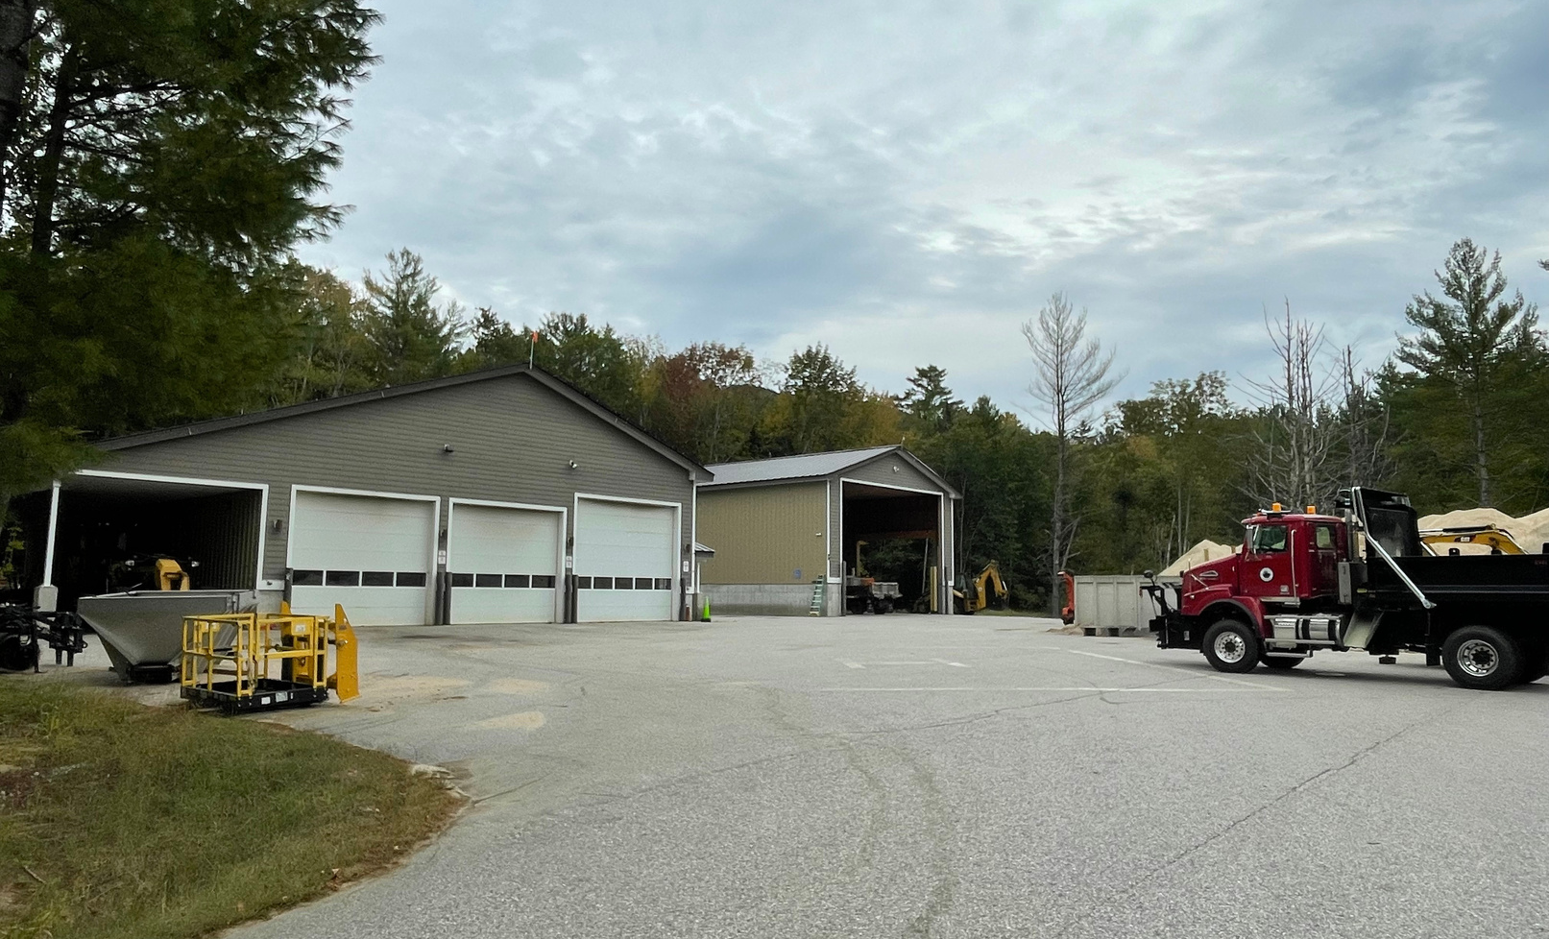
Highway Garage
R14-8 (View on a map)
Current Use
The highway garage is located on the same lot as the town office, police station, and the library. It is physically located behind the fire station.
20
22

Slide 9
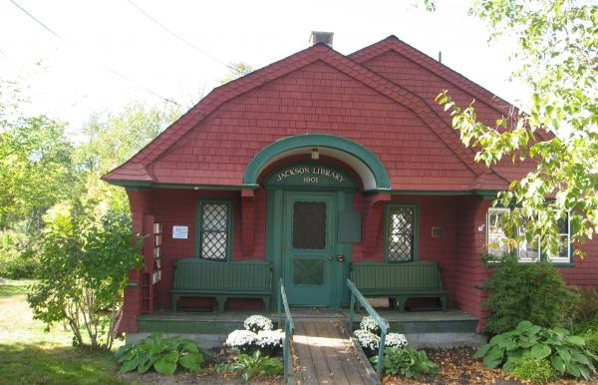
Old Library
V01-38 (View on a map)
Current Use
The Old Library is located at 125 Main Street.
The Jackson Library building was open to the public on August 1, 1901 and used as the Jackson Library until November 2010, when the library moved to its new location. The building was designed by the famed Boston architect William Ralph Emerson and is much beloved by the Jackson residents and visitors to the Mountain Washington Valley. The building is on the National Register of Historical Buildings.
The building is now available for public use for social, cultural or educational events sponsored by Jackson residents and/or community groups.
**The Old Library building is town owned, but located on property owned by the Protestant Chapel Association.
Contact
website: Old Library
phone: 603-383-6861
20
22

Slide 10
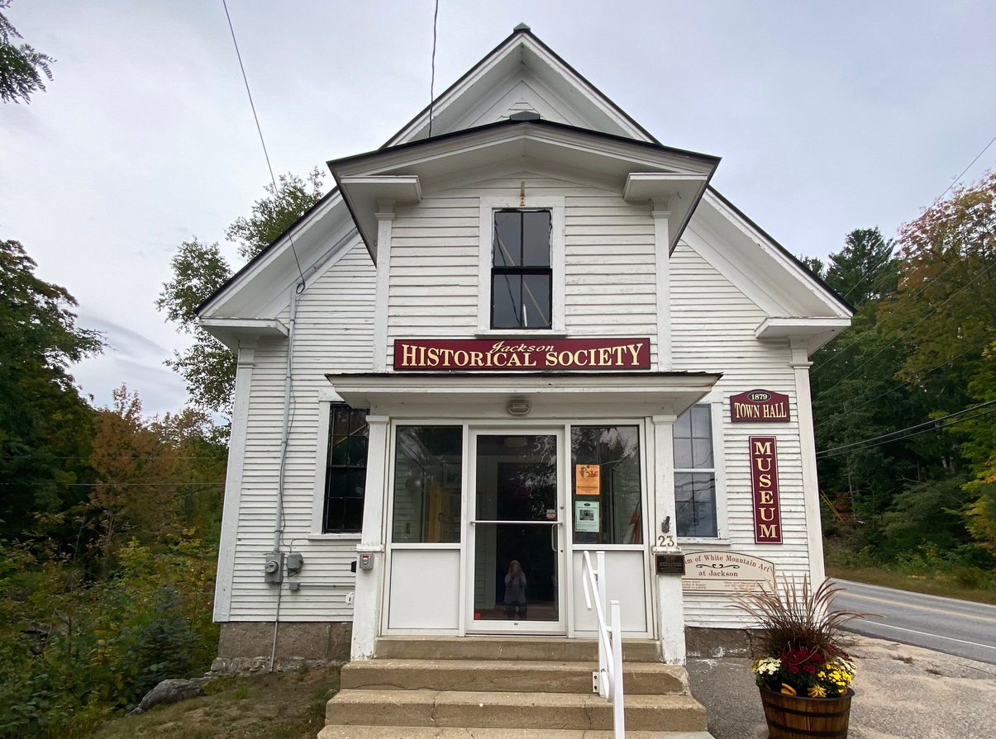
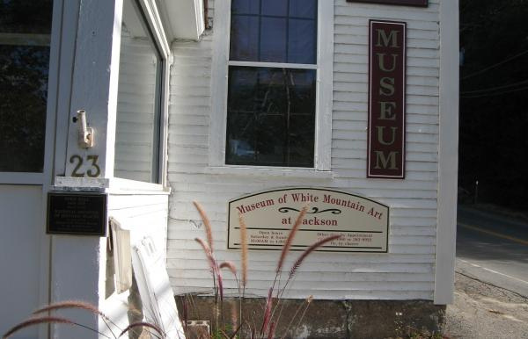
Jackson Historical Society
V03-39 (View on a map)
Current Use
The Jackson Historical Society is located at 23 Black Mountain Road in the old town hall building.
The town of Jackson currently leases the building to the Jackson Historical Society.
Contact
website: Jacksonhistory.org
phone: 603-383-4060
20
22

Slide 11
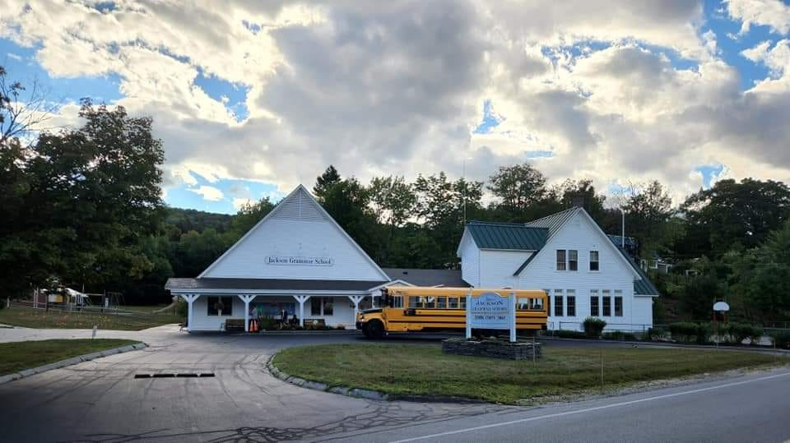
Jackson Grammar School
V02-46 (View on a map)
Current Use
Jackson Grammar School is located at 16 Black Mountain Road, adjacent to the Whitney Community Center. The grammar school offers grades K-6, with 47 students currently enrolled. Students attend 7-8 grades at Josiah Bartlett Elementary school and 9-12 grades at Kennett High School.
Extensive strategic planning has been done to evaluate current needs and plan for the future. View the strategic plan information.
The grammar school offers four classrooms; three offices for admin, principal and special education; and a small library/ group classroom/guidance/language room. The school serves lunch purchased from JBES.
The Whitney Community Center is used for Unified Arts such as Music and PE (weather dependent). Three outdoor classroom areas include a large seasonal tent, post-and-beam pavilion, and a rustic outdoor classroom. These are used for classes, lunch, and other events.
Contact
website: Jackson Grammar School
phone: 603-383-6861
20
22

Slide 12
JOINT MANAGEMENT FACILITIES
20
22

Slide 13
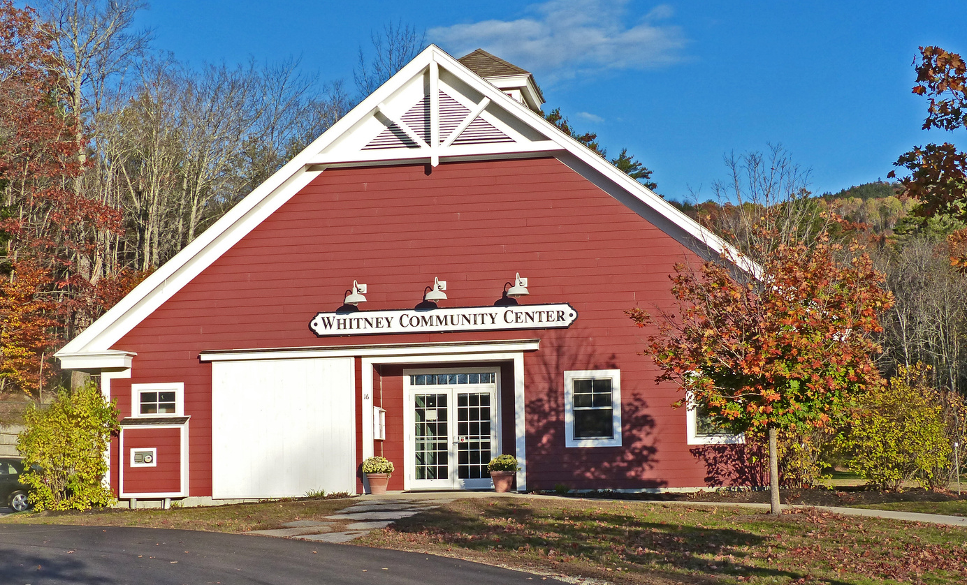
Whitney Center
V02-47A (View on a map)
Current Use
The Whitney Community Center is located at 16 Black Mountain Road, adjacent to the Jackson Grammar School (JGS).
The Whitney Community Center, completed in 2009, was a gift to the town from Betty Whitney. When she passed away in 2005, her bequest funded the construction of the community center as well as an endowment to support maintenance and programming in perpetuity.
The Jackson School District, in collaboration with the Whitney Oversight Committee (school, town, and community members), manage the facility.
The facility is used for:
Art and music classes, as well as JGS functions
Town Meetings and elections
Community events organized and promoted by the Friends of the Whitney Community Center (a nonprofit)
Events organized by groups and individuals for a usage fee
The Whitney is an emergency shelter for the Town of Jackson.
Contact
website: Whitney Community Center
phone: 603-383-6861
20
22

Slide 14
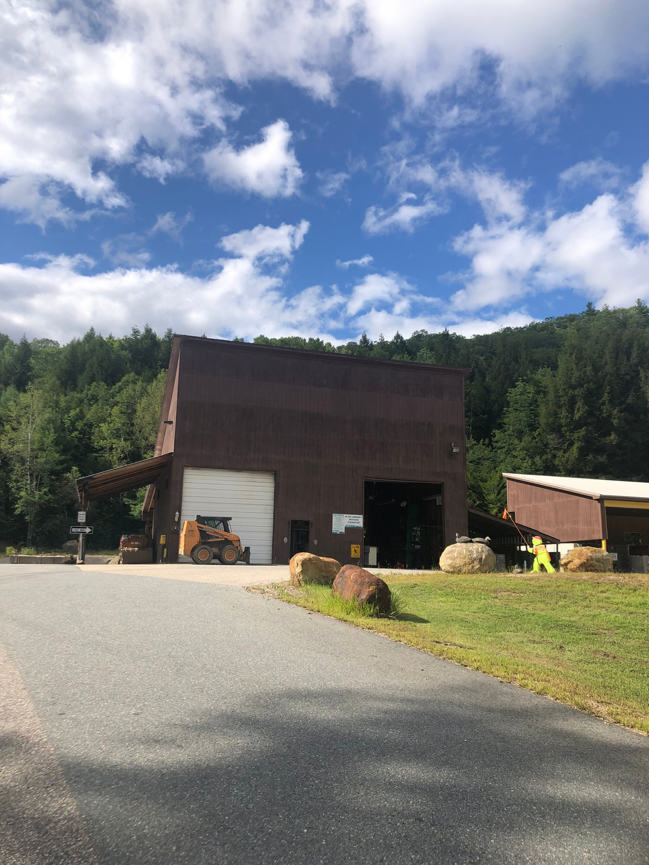
Transfer Station
R13-27 (View on a map)
Current Use
The Bartlett/Jackson shared Transfer Station is located at 102 Transfer Station Road on NH16. The Transfer Station land is located in Jackson, while the buildings and additional land is located in Bartlett.
HOURS
Fri-Tues: 12:00pm to 6:00pm
CLOSED: Wed -Thurs
CLOSED: Christmas Day CLOSES at 4:00pm Christmas Eve
Contact
website: Bartlett-Jackson Transfer Station
phone: 603-383-9129
20
22

Slide 15
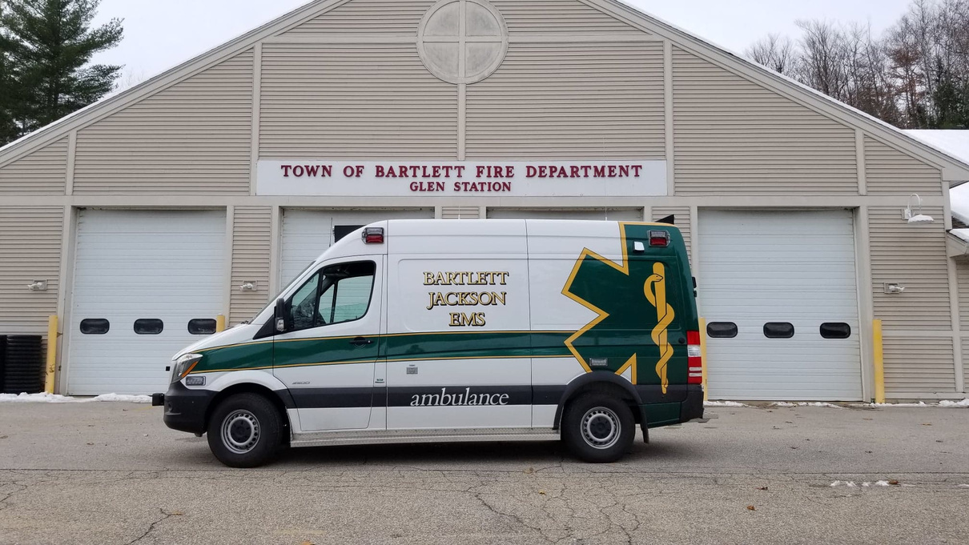
Ambulance Service
NOT A JACKSON FACILITY
Current Use
Bartlett-Jackson Ambulance Service is located in the
Bartlett Fire House at 90 Route 302 in Glen.
Contact
website: Bartlett-Jackson Ambulance Service
phone: 603-383-3651
emergency: 911
20
22

Slide 16
CEMETERIES
20
22

Slide 17
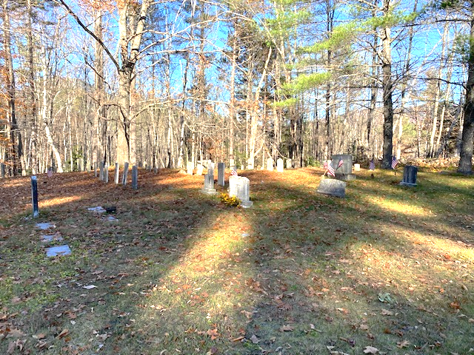
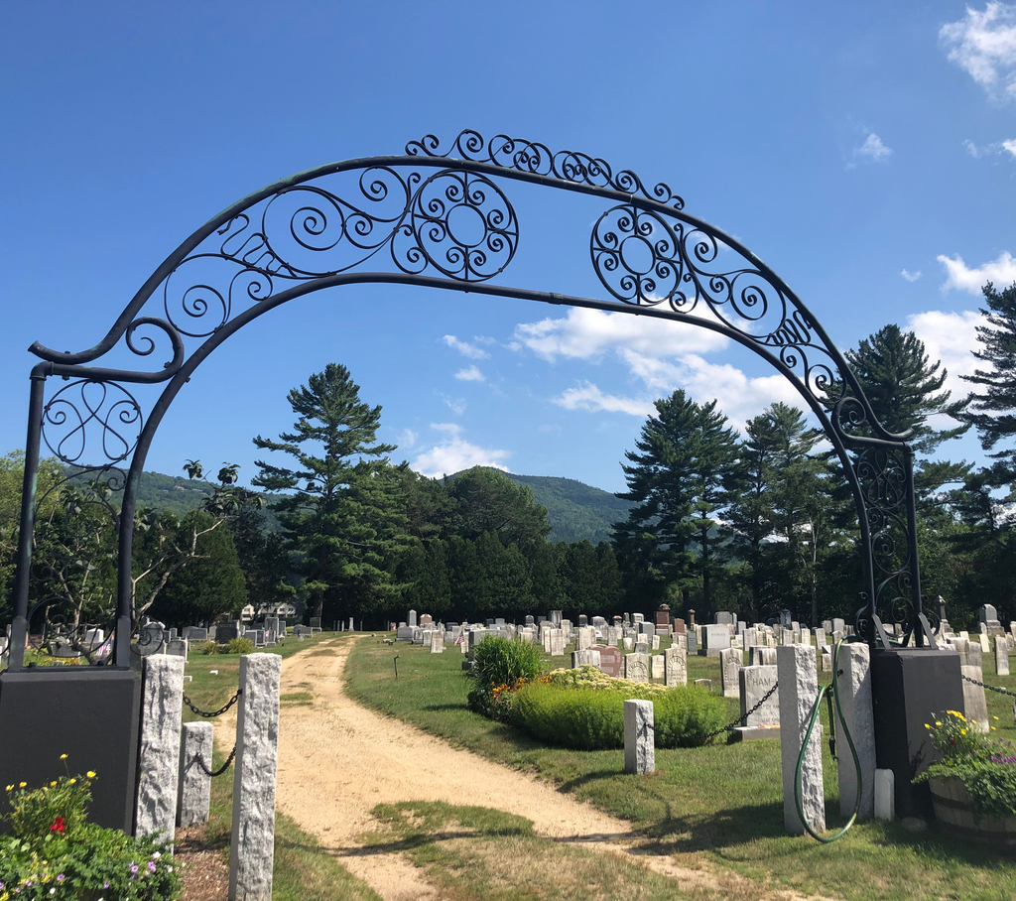
Cemeteries
Dundee Road Cemetery
R30-8&9
Mill Street Cemetery
V02-9
Located on Dundee Road
Located on Mill Road, abutting the Wentworth golf course.
20
22

Slide 18
LAND
20
22

Slide 19
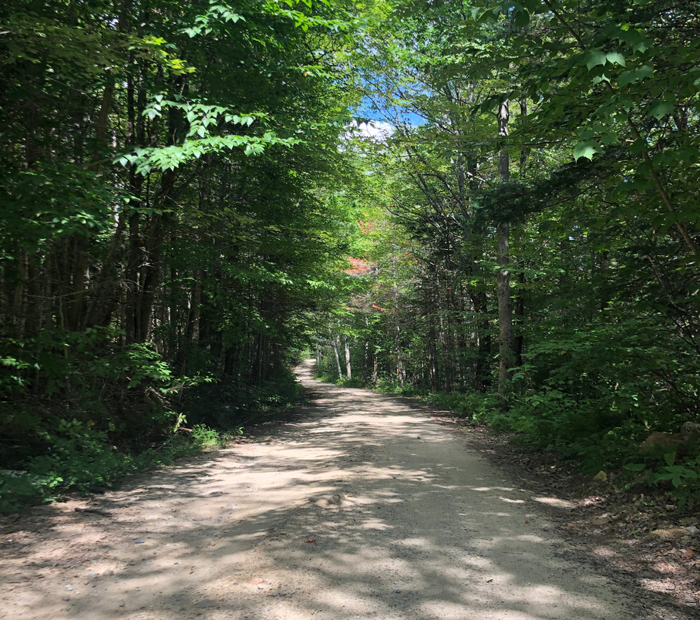
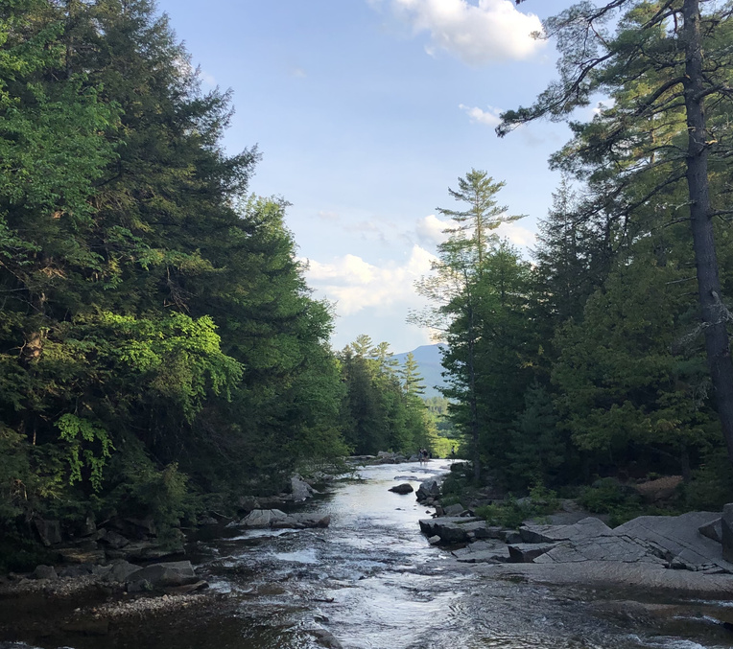
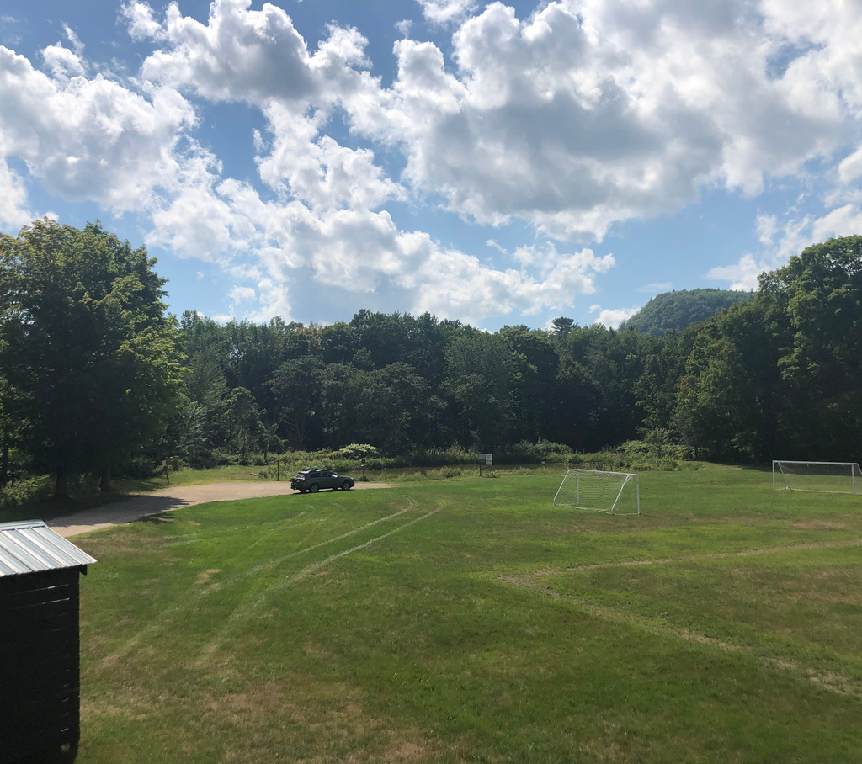
Land
Prospect Farm Land
R07-1
Jackson Falls Park
V02-10Q
Ball Fields Park
V01-42
Located at the end of Carter Notch Road, this land offers access to trails for hiking, running, and biking, as well as nordic skiing with Jackson Ski Touring Foundation.
Located on Carter Notch Road with parking at the intersection of Valley Cross Road, this land offers public access to Jackson Falls and the Wild & Scenic Wildcat River..
Located on Main Street, the Ball Fields Park offers a pond, access to the river, soccer and baseball fields and is host to a number of community events.
20
22

Slide 20
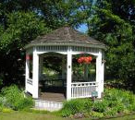
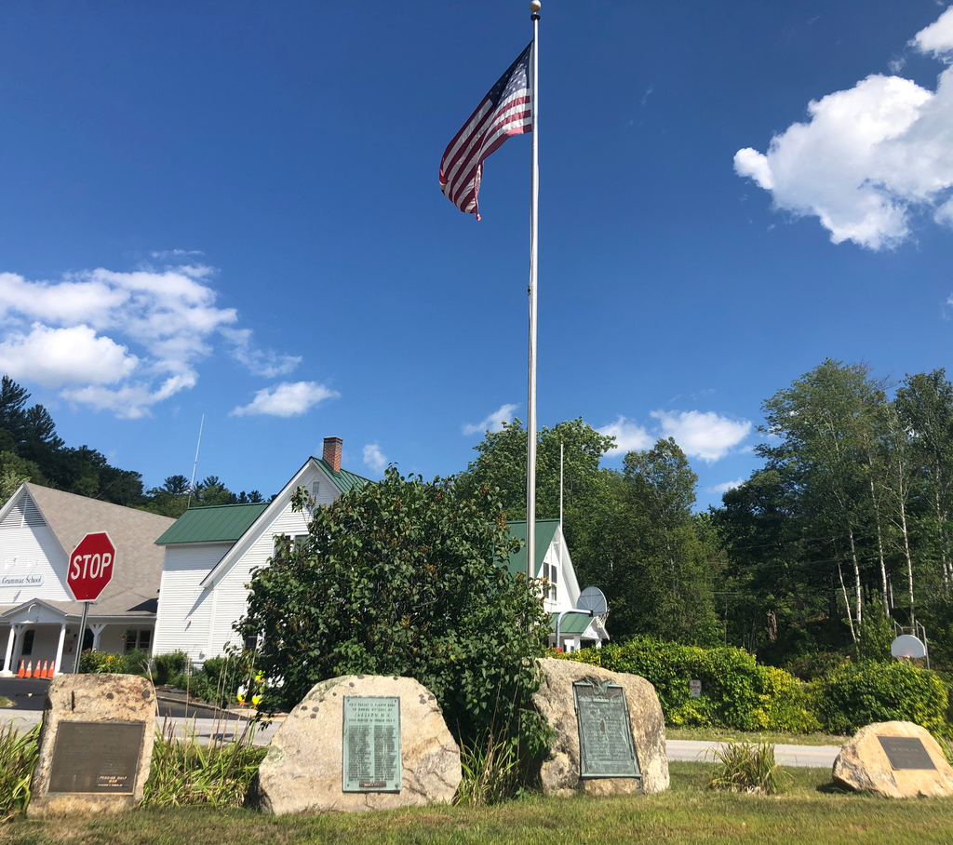
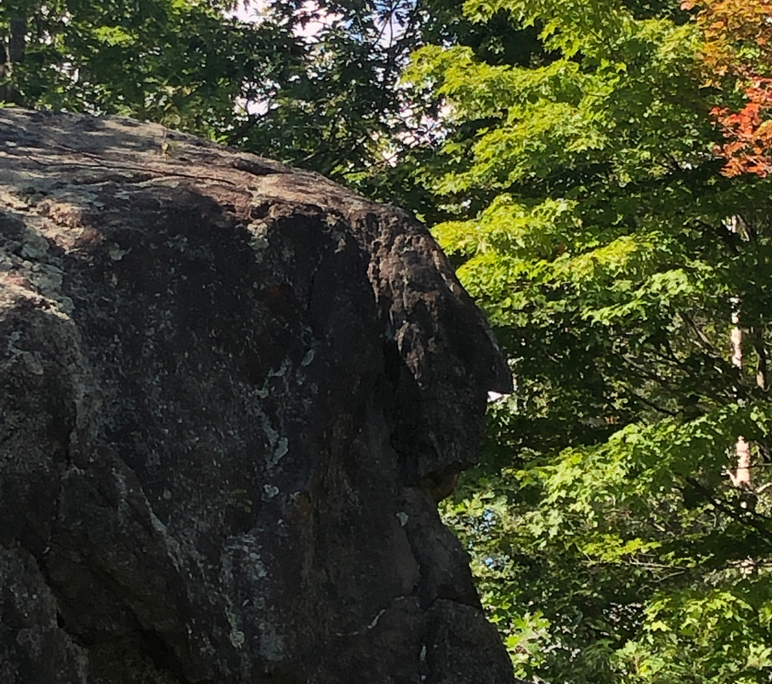
Land
Gazebo Green Space
V02-40
Unnamed Park
R14-1A
Profile Rock
V10-105
Located on Black Mountain Road, adjacent to the Historical Society, this green space is home to a gazebo and many holiday events.
Located at the intersection of 16B/Black Mountain Road and Main Street, this 0.27 acre land includes the town memorials...
Otherwise known as Washington Boulder, this small property is located on TIn Mine Road.
20
22

Slide 21
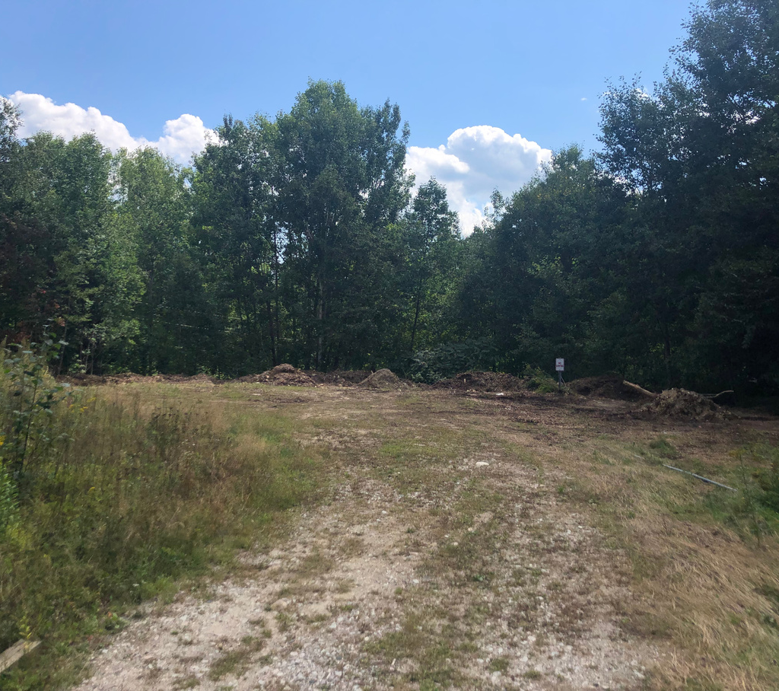
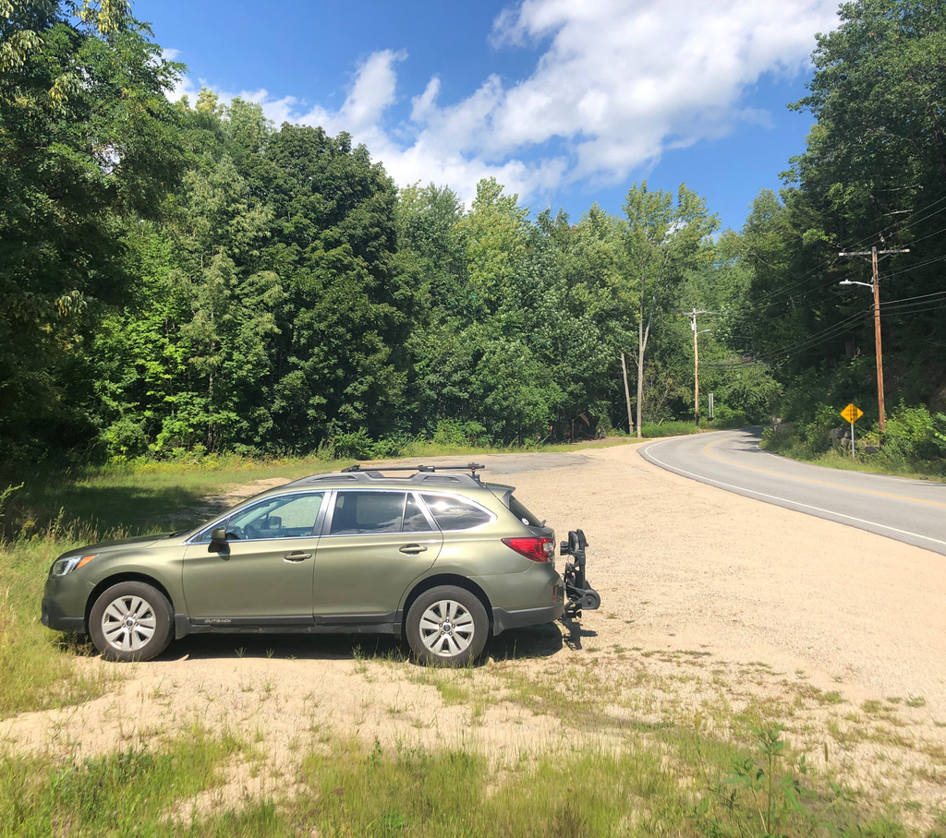
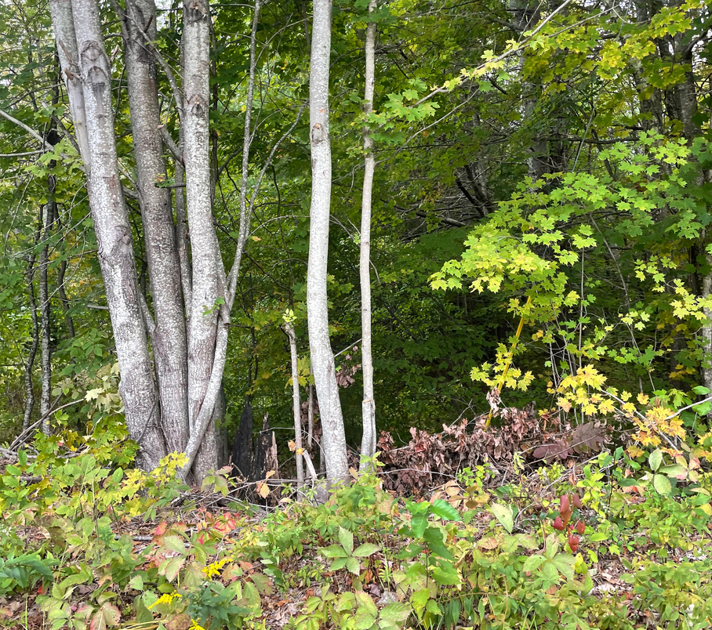
Land
Former Transfer Site
R18-15
Black Mountain Parking
V02-38
Thorn Hill Land
R14-9
Located on Meloon Road, this former transfer site is 3.5 acres.
Located on Black Mountain Road, this parking area is located adjacent to the Historical Society.
This 2 acre parcel is located
behind the town garage.
20
22

Slide 22
Small Parcels
NH Route 16
R09-32
Iron Mountain Road
R11-16
Old Jackson Road
R12-111
1 acre lot along the east side of NH Route 16 where the roadway narrows near the river.
0.25 acres along a waterway within a 4,000+ acre lot, not owned by the town
0.52 acres at the intersection of Old Jackson Road and NH Route 16. May be owned to protect roadway visibility.
Eagle Mountain Road
R12-16
Meloon Road
R18-11B
Jackson Highlands Road
V07-53 & 54
20
22
0.21 acres between Eagle Mountain Road and Adams Road culdesac.
0.25 acres at the terminus of Candy Cane Lane, which is a private road located on Meloon Road
0.39 and 0.51 acres along Jackson Highlands Road

Slide 23
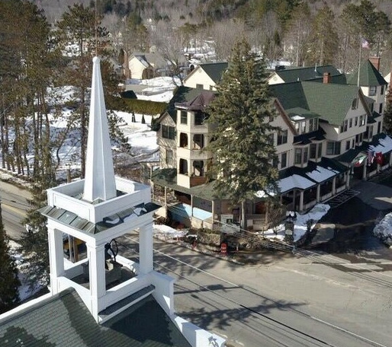
Other
Jackson Community Church
The town of Jackson does not own the church building; however, the building is used during town emergencies.
The community hall (rear) of the church operated as a Preschool for 12+ years, but does not currently. There is a playground behind the church maintained by the church, but owned by the Wentworth Hotel.
20
22

Slide 24
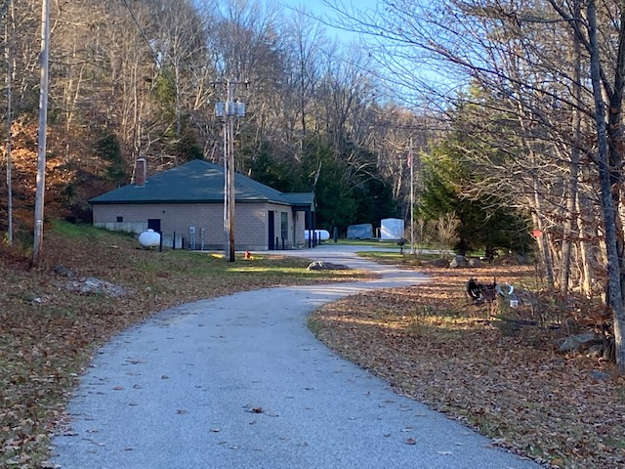
Other
Water Precinct
The Jackson Water Precinct was established as a village district in 1972 after being purchased from the privately owned Jackson Water Company. The Precinct is a separate entity that manages the Jackson water district which serves the village area. It is managed by a Board and has its own budget. Any changes to the original bylaws need to be reviewed by the Selectman.
Potable and aesthetically pleasing water and adequate fire protection are essential to the village district of Jackson. For additional information: www.jackson-nh.org/jackson-water-precinct
20
22

Slide 25
LEARN MORE
Visit us online at
jackson-nh.org/facilities-committee
Additional Resources
Town Website: jackson-nh.org
E-news: Subscribe for town updates
Jackson Bridge: Join the community list serve
Jackson Flicks: Watch town meetings online
Town FAQ: Quick reference sheet for residents
20
22

